Slide 1
Office 365 Development
July 2014

Slide 2
Course Agenda
Introduction to Office 365 Development
Module 1: Deep Dive Apps for Office in Outlook
Module 2: Deep Dive Apps for Office in Word
Module 3: Deep Dive Apps for Office in PowerPoint
Module 4: Deep Dive Apps for Office in Excel
Module 5: Deep Dive into SharePoint Hosted Apps
Module 6: Deep Dive into Provider Hosted Apps
Module 7: Deep Dive into Security and OAuth
Module 8: App Lifecycle Management

Slide 3
Deep Dive into Apps for Office in Word
Speaker
Speaker

Slide 4

Agenda
Introduction to Apps for Word
Developing Apps for Word
Reading and Writing with Documents
Document Bindings
Packaging and Deployment

Slide 5
What is an App for Office?
A Web page loaded inside an Office Application
Embedded inline or as task pane within documents, mails or appointments.
Works in both Office Applications and Office Web Applications
Office application extensions using Web technologies
HTML 5 and CSS used to construct user interface
JavaScript and jQuery used to add executable logic and event handlers
App can provided code to read/write content to/from Office documents
App can call Web services hosted over Internet or running within local network
Notes:
An App for Office can be seen as a Web page loaded inside an Office Application. In some cases it will appear embedded inline within the document. In other cases it might appear as a task pane or within a message in Outlook. Note that the architecture for Apps for Office has been designed to work in both Office Applications and Office Web Applications.
WEF and Apps for Office allow Office applications to be extended in such as way so that they can leverage Web technologies such as HTML 5 and CSS for rendering user interface as well as JavaScript and jQuery to add behavior. When you write the JavaScript code for an App for Office, you can call REST APIs such as those added to SharePoint 2013 to retrieve and update data from across network.

Slide 6
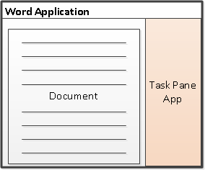
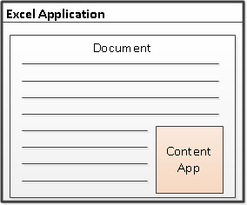
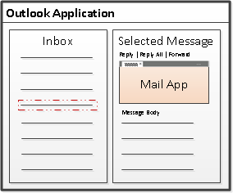
Designing Apps for Office - Shapes
Apps for Office come in three different shapes
Task Pane App (only shape supported by Microsoft Word)
Content App
Mail App
Notes:
When you begin to design an app, you must pick one of the three different shapes. You can create a document-based app as either a Task Pane App or a Content App. Alternatively, you can create a Mail App that targets Outlook and Outlook OWA.

Slide 7
App for Office Runtime Environment
Web Extensibility Framework (WEF)
Allows Web page content to render inside Office Application
Allows Web page code to run within a set of constraints
Allows Web page code to interact with Office documents
Allows Web page code to interact with Exchange items
WEF provides runtime environment for Apps for Office
Apps for Office provide basis for a component architecture
Apps for Office provide ability to publish to App Catalogs and/or Office Store
Apps for Office can be deployed in private networks
Notes:
The Web Extensibility Framework (WEF) is a new development platform used to extend Office applications. This platform allows Web page content to render inside Office Application and to interact with Office documents such as Word document and Excel workbooks and Exchange items such as messages and appointments.
The WEF development platform is used to develop Apps for Office. Apps for Office provide basis for a component architecture which allows developers to build apps which target Office application and Office Web applications such as Excel services and Outlook Web Access.
WEF and the Apps for Office development model provide foundation for distribution of apps using an app directory such as the Office Store and the App Corporate Catalog used to deploy apps in private networks.
Throughout the beta cycle of Office 2013, Apps for Office have been given a codename of "Agave". Note that this codename is only intended for the beta cycle and will disappear by RTM when they will just be called "Apps for Office" or a variation thereof.

Slide 8




Anatomy of an App for Office
Each App for Office is based on XML-based manifest
Manifest points to a Web page
Manifest defines the type of the App for Office
Manifest defines which Office applications it supports
Manifest defines required capabilities
App for Office
Catalog Server
Web Server
App for Office
App for Office
Manifest
<XML>
Web
Page
HTML+JS
Notes:
Every App for Office must be distributed with an XML-based manifest which contains information about the app itself. For example, the app manifest contains an address to a Web page on the Internet which is used to load the app. The app manifest also includes information which indicates which Office applications it supports. The app manifest also defines the required capabilities which represent the set of permissions that the app needs in order to run and complete its work.

Slide 9
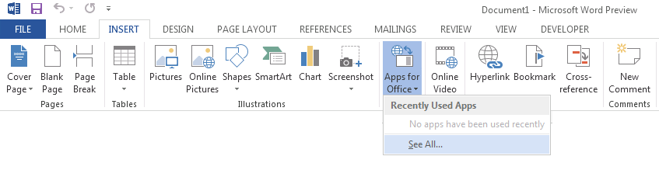
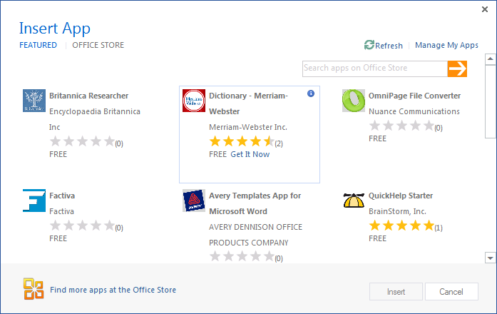
Adding a App for Office using the Insertion UI
Apps for Office insertion UI located in Ribbon inside Insert Tab
Dialog allows you to add and start App for Office app
Notes:
Office 2013 applications provide users with the ability to discover apps and insert them. In Word and Excel, this support is included in the Ribbon inside the Insert Tab. As you can see from the slide above, the drop-down menu for inserting apps has a caption of "Agaves" in the beta cycle and will be updated to say "Apps" before RTM.
When you drop down the Apps menu from the ribbon, you can see recently selected apps. If you click "Select All", you will be prompted with a dialog that allows you to look in various app directories. Once you find an app you want to use, you can click the Start button to insert the app into the current document and start it up. After this, you can save the current document which will then include the app.

Slide 10
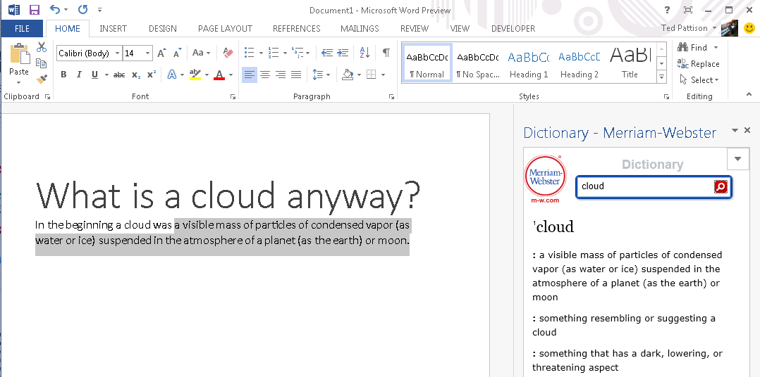
Task Pane App User Experience
Familiar User Experience
Leverages familiar Office UI paradigm
Reference Information
Ideal for providing reference information associated with document.
Notes:
One reason to create a task pane app is that it provides Office users with a familiar user experience. For example Microsoft Word and Microsoft Excel have exposed many of its internal features using task panes so task pane apps provides a familiar Office UI paradigm.
Task pane apps are ideal for providing users with reference information. For example, a task pane app can perform Internet searches or lockups and provide reference information that can be inserted back into the current document.
This slide contains a screenshot showing the app after it has been inserted in a document. In Microsoft Word 2013. Different apps provide different user experiences. This app which is available for free on the Office Store allows the user to leverage the Marriam-Webster online dictionary lookup service to look up words and terms right from within Microsoft Word.

Slide 11
Developing Apps for Word

Slide 12
Visual Studio Experience
Create new App for Office project
Create/design user interface for Web page
Enhance Web page with CSS and JavaScript
Set project properties in manifest
Run!
Notes:
This slide is pretty self-explanatory and demonstrates just how easy it is to create and test your first App for Office using Visual Studio 2012. First, you will create a new project using one of the new project templates in Visual Studio 2012. Next, you will create the user interface for the app using HTML5 and CSS. After that, you add behavior to the app by writing JavaScript. Finally, you will update the XML file which serves as the app manifest. After that, you can press the {F5} key to test and debug your app.

Slide 13
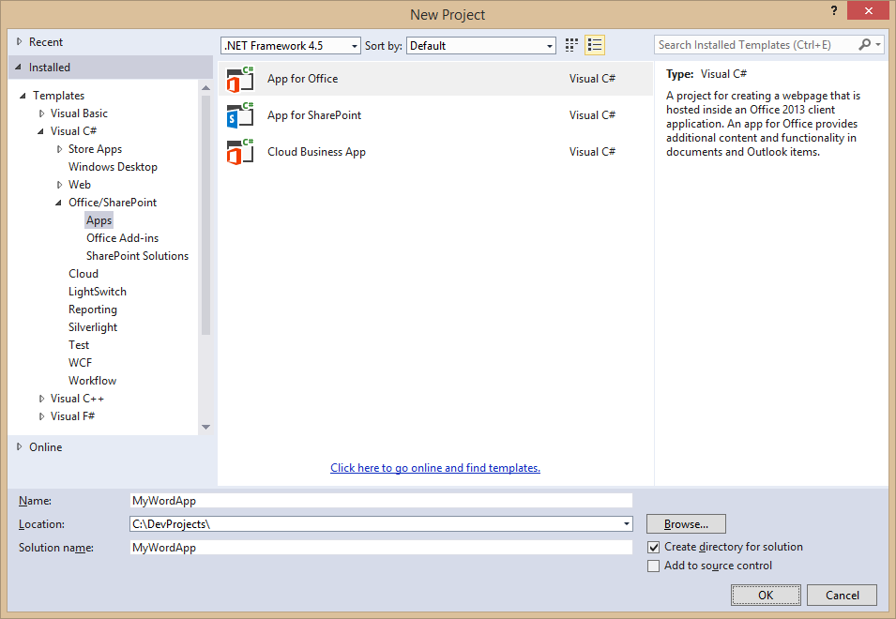
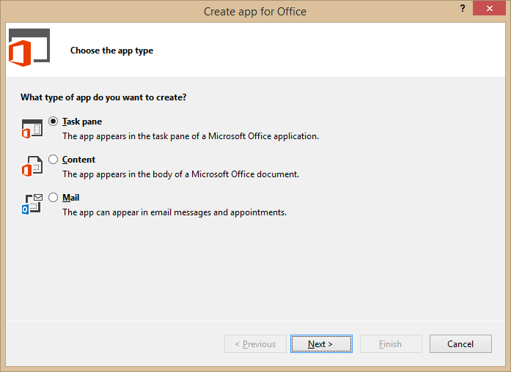
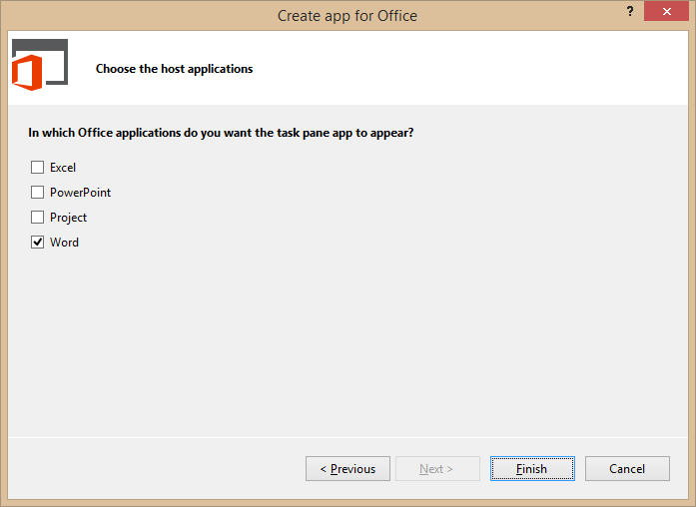
Create New App for Office Project
Create project based on App for Office 2013 project template
Dialogs appear and prompts you for specifics about the app
You must choose (1) the app shape and (2) which Office application are to be supported
Notes:
Visual Studio has a new project template for Apps for Office. These project types gives you a starter project with a web page and manifest.

Slide 14
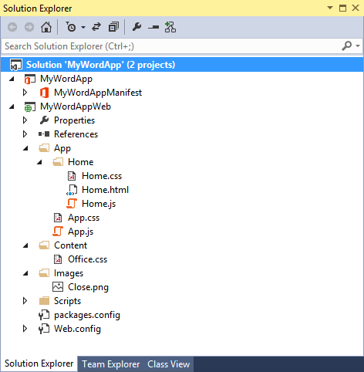
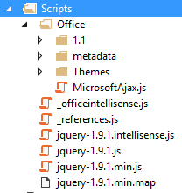
App for Office Project Structure
App for Office solution has two projects
Top project contains app manifest
Bottom project for remote web
Remote Web Project is ASP.NET Website
Contains HTML, CSS and JavaScript source files
Integration with jQuery library already included
Notes:
The slide shows the initial structure of a task pane app created with the Visual Studio 2012.

Slide 15
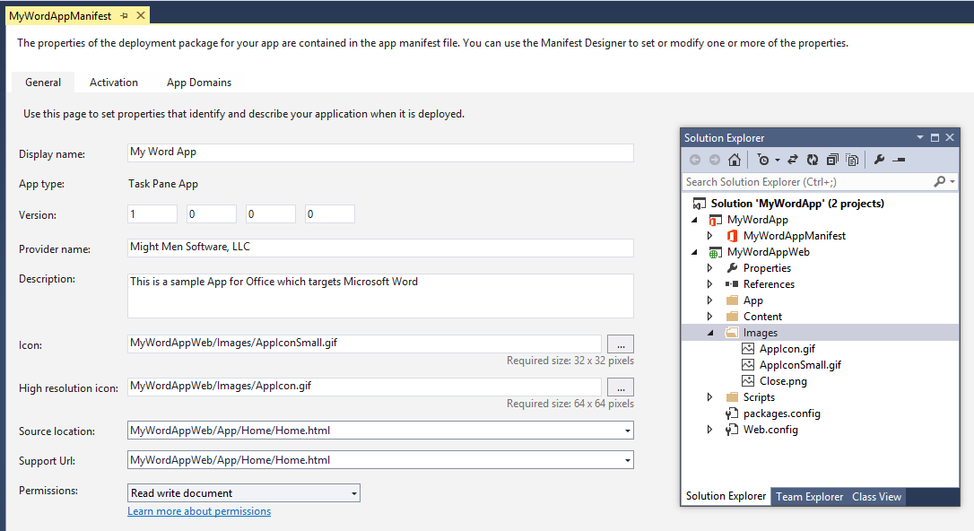
App Manifest Designer
Notes:
This slide shows the Visual Studio designer for an app manifest in a task pane app. It will look different for other types of Apps for Office.

Slide 16
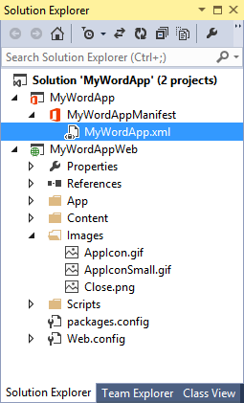
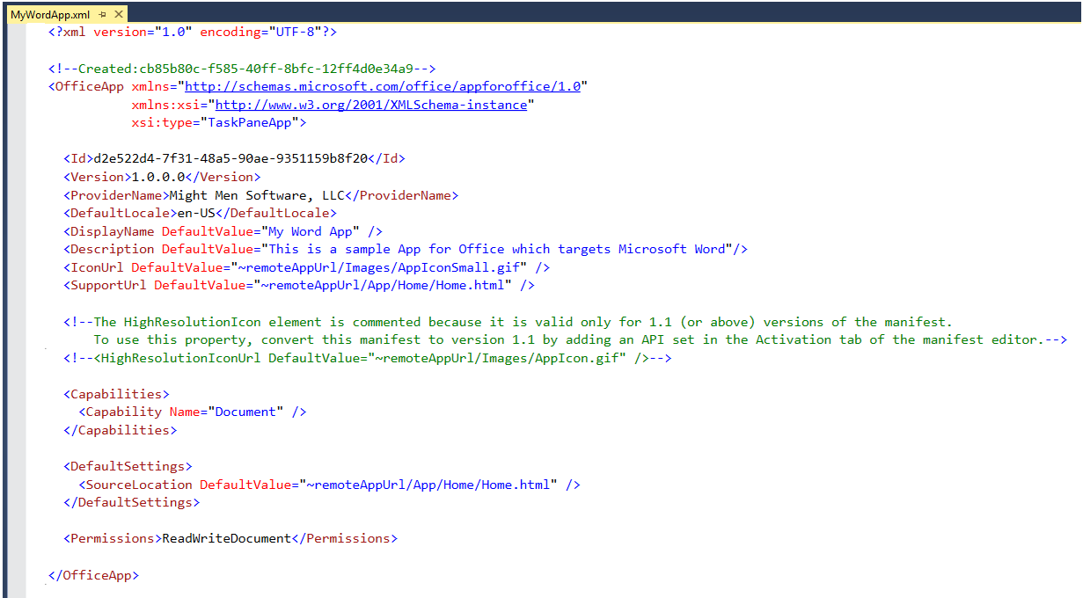
App Manifest - XML View
Notes:
There are times when it is also useful or necessary to examine or update the manifest in XML view. You can enter XML view by clicking the XML file in the Solution Explorer.

Slide 17
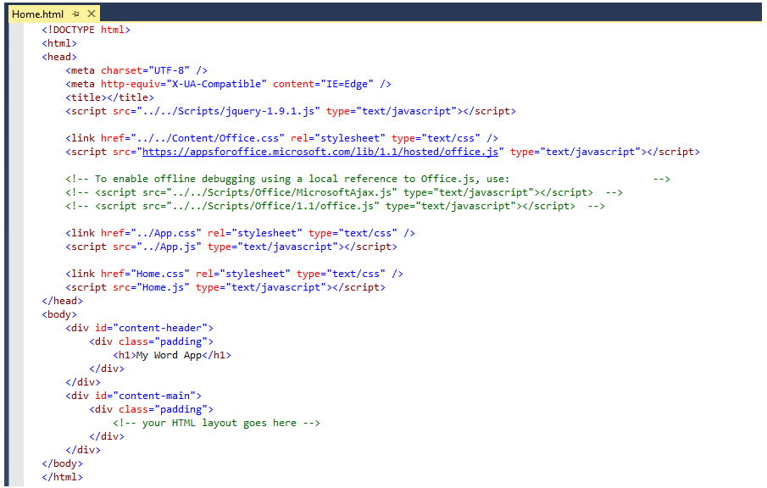
Create the HTML for a Web Page
Notes:
Each app has a source location which points to a entry point Web page somewhere on the Internet. Here is an example of a simple Web page that is used to load a task pane app. Note that this page must link to any required CSS files and JavaScript that will be adding styles or behavior behind the app. Visual Studio automatically adds the links for jQuery and ASP.NET AJAX. Also note that the page adds HTML elements which are often created with ids and/or classes.

Slide 18
Navigation and Links
DOs
Provide hyperlinks to open in browser
Design app to fit on one host page
Use iFrame with navigation bar if absolutely necessary
Consider ways to provide messages to users
DON’Ts
Expect hyperlinks to open in app window (blocked).
Send users to trapped pages via poor navigation trails
Use alerts
Notes:
This slides discusses what to use and what to avoid when designing an app.
Do provide hyperlinks within an to open Web pages in a new browser window. This makes it easier to design an app that fits cleanly on a single host page. Within the host page you can also use an iFrame to host content and provide a navigation bar if needed to change the contents of the iFrane using JavaScript. Also consider how your app will provide informational messages to the user. Typically this is done by adding a HTML element such as a div to the host page and dynamically writing text inside using JavaScript.
Here is a list of design issues to avoid. When creating hyperlinks, do not use <a> tags without a target attribute to open the link in a new window browser. You will find that such links are blocked by the Office UI if they attempt to take the user to a different domain. Also avoid links which navigate the user to pages which do not allow them to return to the start page as there is nothing similar to the back button inside the browser. Also, avoid interaction with the user using the poor man's technique of using the JavaScript alert function which has more restrictions inside an app than it does when used inside a browser.

Slide 19
Context Menus and Settings Controls
Full control of what is inside the App for Office
Developer can override the right-click Context Menu
No Control to customize the App container menus.
Developer cannot customize Task Pane or Content/Chart object menu
Ability to save settings to “property bag”
Property bag values saved with the app in the document
With Mail Apps for Office property bag values save within Exchange
Notes:
If you want an app to provide custom menus to the user, you should understand that you have control only of the users interface inside the app but not any UI elements outside. You can override the app context menu that appears at the upper right-hand corner of an app. However, when creating an app you have no control over customizing any other menus within Office apps.
Also remember that you have the ability to save custom properties as name values pairs using the settings API. These names value pairs are saved within the current document with task pane apps and with content apps. With mail apps these property values are saved within Exchange along with the host message or appointment.

Slide 20
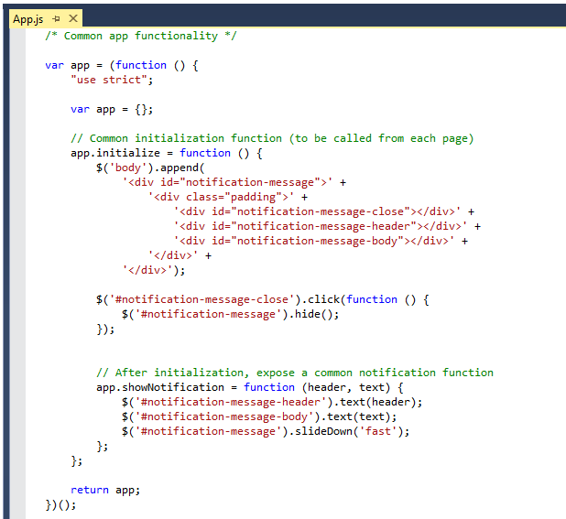
Code Added by Visual Studio
Notes:
JavaScript is the language that is used to add executable code and behavior to a App for Office. The JavaScript you write for an app will typically take advantage of the various JavaScript APIs supplied for Office.js and other JavaScript library files for specific Office applications such as Word, Excel and Outlook. In addition to the Office JavaScript APIs, the JavaScript code you write for an app for Office can also take advantage of the ASP.NET AJAX library as well as jQuery.
The Office JavaScript API provide a top-level named Office which provides an initialize function. By overriding this function as shown in the code above, you can write code that will automatically execute as the end of the initialization process when an app is started. A common approach is to register a jQuery document ready event handler inside this function.

Slide 21
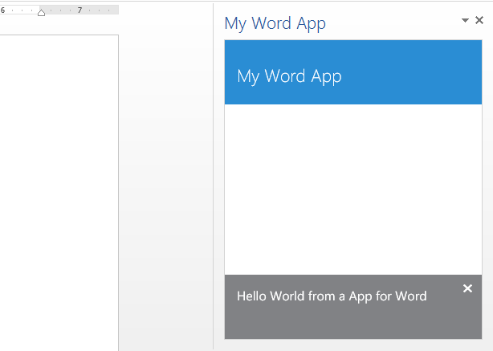
Test/Debug the Apps for Office using {F5}
When you press the {F5} key…
Visual Studio builds the app package and temporarily registers it
Visual Studio starts Microsoft Word and adds the app to new Word document
Notes:
When you press the {F5} with a Visual Studio 2013 project for an task pane app or a content app, Visual Studio automatically adds a registry entry to allow Office applications such as Word and Excel to discover the app which makes it possible to add it to a document.

Slide 22
demo
Creating an App for Office Targeting Microsoft Word

Slide 23
Reading and Writing with Documents

Slide 24
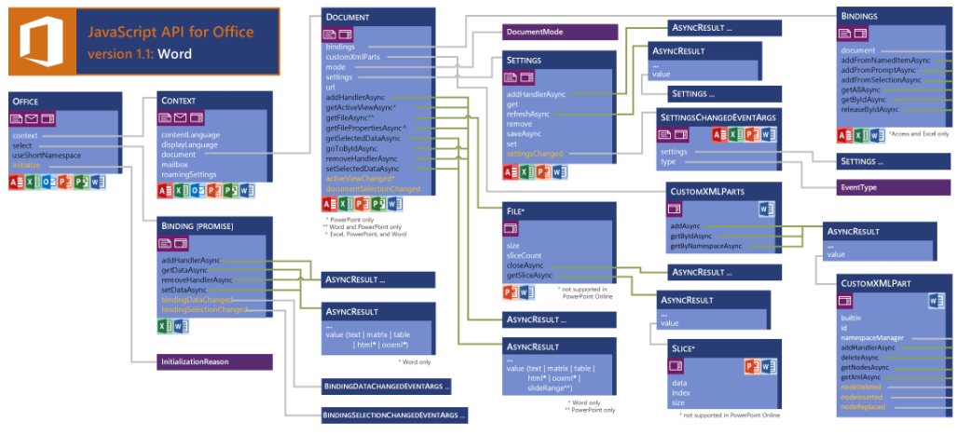
JavaScript API for Word Apps (v 1.1)
see more at http://msdn.microsoft.com/en-us/library/office/fp142185(v=office.1501401).aspx

Slide 25
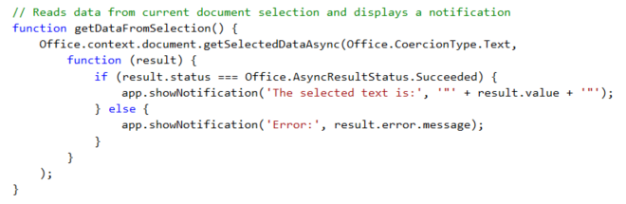
getSelectedDataAsync()
Use this function to read from document select
Notes:
The function getSelectedDataAsync is used to read content from the selected region of the current Word document.

Slide 26
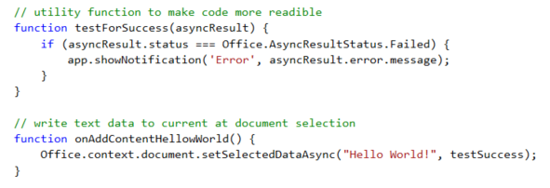
setSelectDataAsync()
Use this function to insert content into document
Notes:
The function setSelectedDataAsync is used to write content into the selected region of the current document. If there is no selected region, the content is added at the location of the cursor.

Slide 27
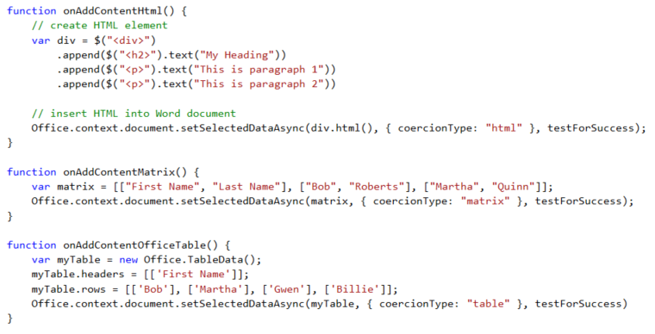
Coercion Types
Coercion types make it possible to read/write content in different formats
text - string value
html - HTML content
matrix - array of arrays
table - table of rows and columns
ooxml - Office Open XML format

Slide 28
demo
Writing Content To the Selected Region of a Word doc

Slide 29
Document Bindings

Slide 30
demo
Creating App Bindings using Word Content Controls

Slide 31
Bindings in App for Office with Word
Word supports data binding to content in document
Word currently only supports binding with Rich Text content control
Bindings created using content control Title which serves as ID
You can read and write bound content regardless of where selected region is
You can register event handlers to fire when user updates bound content
Notes:
Bindings are import because they make it so you can read and write to specific areas in a Word document without having to worry about what the selected region is

Slide 32
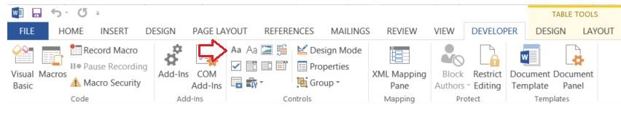
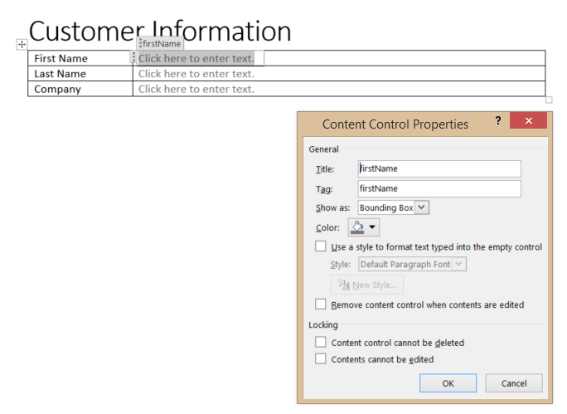
Adding Content Controls
Add Rich Text content control from Developer tab
Modify content control Title property to assign ID for binding
Notes:
To add content controls, you must enable and show the Word Developer tab. Then you can add one or more Rich Text content controls to a Word document for binding. Also note that you must assign each content control with a unique Title property because that is the ID you will use to bind to the content control.

Slide 33
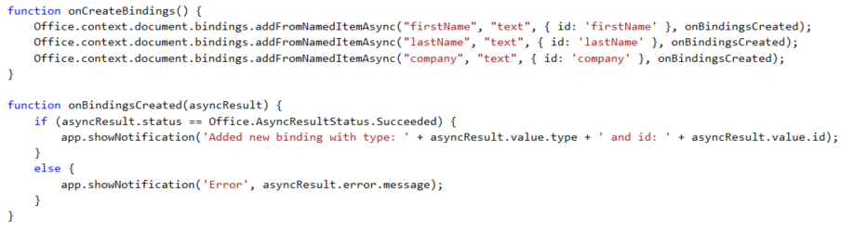

Adding Bindings in JavaScript
Notes:
The top code listing shows how to create bindings in JavaScript code using addFromNamedItemAsync. Note that the first parameter (e.g. "firstName") is used to indicate which content control you want to bind to. The third argument (e.g. { id: 'firstName' } is used to create the binding ID that will be used to retrieve the binding when call the Office.select function.
Note that the call to Office.select gets the binding using a syntax of "bindings#" followed by the ID of a registered binding.

Slide 34
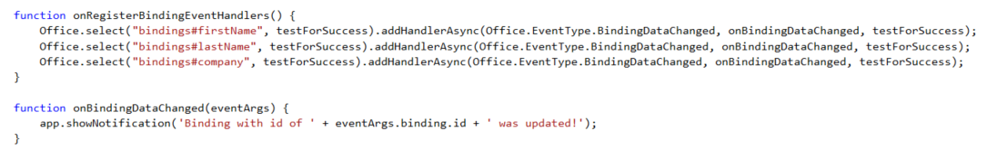
Adding Event Hander Bindings
Event handlers added using addHandlerAsync
Callback function called automatically when user updates binding content
Notes:
This code shows how to register an event handler on a binding using the addHandlerAsync function.
The call also registers a callback function named onBindingDataChanged which is called automatically when user updates the bound content.

Slide 35
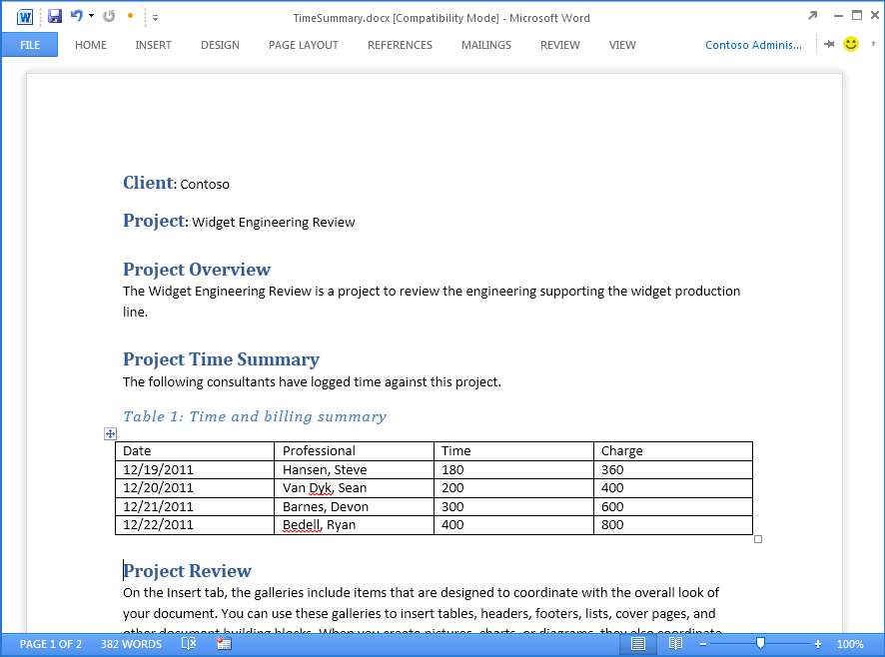
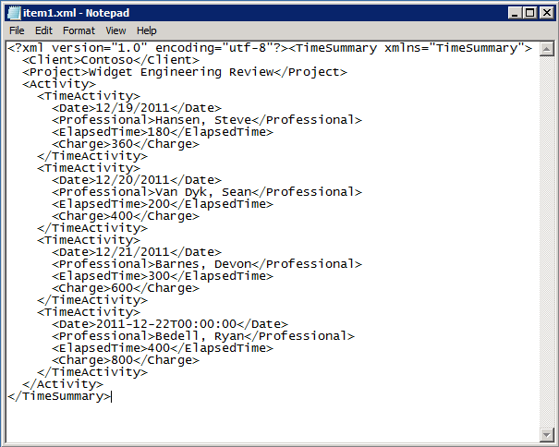


Open XML and Content Control Refresher
The TimeSummary document contains custom XML document
Inner XML document contains elements bound to Word Content Controls
Custom XML document can be modified/updated by your app
Custom XML document can be modified by user input
Word file structure
_rels
customXml
Content Controls mapped to custom XML part
docProps
word
Content Types
Notes:
Microsoft Word intorduced Content Controls in Office 2007. Content controls act as containers and user input controls for specific kinds of content. A valuable role of content controls is that they can be mapped to nodes within a custom XML part which is an XML document with custom content which is embedded within a Office document such as a DOCX file..
With Office 2013, there is a new content control for repeating sections. A Repeating Section content control provides the capability to bind to a collection of nodes which typically represent the many side on a one-to-many relationship as in the case where a single time summary document has many time activity entries.

Slide 36
Packaging and Deployment

Slide 37
App for Office Deployment
Steps
Deploy the remote web to Windows Azure or to other web server
Build app package which must include HTTPS URL of remote web
Upload app package to app catalog
Choosing An App Catalog
SharePoint App Catalog is preferred because it offers several advantages
File Share App Catalog deployment is a simpler, less-powerful option
Notes:
When it is time to deploy an app, the actual deployment is similar to standard web site because you must make the Web page for an app and the office supporting files available on a Web server. However, you must also publish the manifest to make the app discoverable for installation. IT admins can designate trusted App Catalogs via Global Policy Objects (GPO). Note that the manifests for Mail Apps must be uploaded to Exchange 2013 App Catalog.

Slide 38
SharePoint App Catalog
Designed for private corporate networks
Provides users with catalog of pre-screened and pre-approved apps
Often used to deploy apps developed in-house of by 3rd party ISV
Supports document-based apps (i.e. Task pane apps and Content apps)
SharePoint App Catalog hosted using Site Collection
Actual catalog is document library containing app manifests
Administrator can configure app for Office security settings
Notes:
SharePoint 2013 implements the App Catalog using a site collection created from a special site template. The app Catalog is designed for Office 365 and for private corporate networks in that it is available to only to users who have been granted access. It provides users with catalog of pre-screened and pre-approved apps. An App Catalog can be used to deploy apps developed in-house of by 3rd party ISVs. Note that the App Catalog in SharePoint supports document-based apps (i.e. Task pane apps and Content apps).
As already mentioned, the SharePoint App Catalog hosted using a SharePoint 2013 site collection. The actual catalog is simply a document library to which app manifests are uploaded. The administrator can configure app security settings that controls who can see and install the apps inside.

Slide 39
File Share App Catalog
Provides Simplest Means to Deploy Apps for Office
Does not require either SharePoint or Exchange
Apps for Office manifests copied to Windows File Share
Office Applications configured to read file share to discover Apps for Office
Client machine requires registry entry with file share path
Notes:
A File Share App Catalog provides the easiest way to deploy Apps for Office. It does not require either SharePoint 2013 or Exchange 2013. Instead, app manifest are simply copied to a Windows file share. Of course, the user desktops running Office Applications must be configured configured with the correct file share path to discover Apps for Office which can be done manually by user or centrally using GPO.

Slide 40
demo
Deploying an App for Office using Windows Azure

Slide 41

© 2012 Microsoft Corporation. All rights reserved. Microsoft, Windows, and other product names are or may be registered trademarks and/or trademarks in the U.S. and/or other countries.
The information herein is for informational purposes only and represents the current view of Microsoft Corporation as of the date of this presentation. Because Microsoft must respond to changing market conditions, it should not be interpreted to be a commitment on the part of Microsoft, and Microsoft cannot guarantee the accuracy of any information provided after the date of this presentation. MICROSOFT MAKES NO WARRANTIES, EXPRESS, IMPLIED OR STATUTORY, AS TO THE INFORMATION IN THIS PRESENTATION.

